Slide 1

ព្រះរាជាណាចក្រកម្ពុជា
ជាតិ សាសនា ព្រះមហាក្សត្រ
សាកលវិទ្យាល័យ អាស៊ី អឺរ៉ុប
មហាវិទ្យាល័យវិទ្យាសាស្រ្ត និងបច្ចេកវិទ្យា
ដេប៉ាតឺម៉ង់វិទ្យាសាស្រ្តកុំព្យូទ័រ
សម្រង់វត្ដមានដោយប្រើ QR code QR code attendance
កិច្ចការស្រាវស្រាវថ្នាក់អនុបណ្ឌិត ក្រុម ២
ជំនាញ: បច្ចេកវិទ្យាព័ត៌មាន មុខវិជ្ជា Mobile Application Programing
រៀបរៀង និងចងក្រងដោយ៖
១. លោក សុខ រតនា
២. លោក វង្ស សុវណ្ណតារា
៣. លោក រ៉ា បូរី
៤. លោក ខៀវ សុវិសាល
៥. លោក សួស តារា
ណែនាំដោយសាស្ដ្រាចារ្យ
SOK PONGSAMETREY
២០២៤

Slide 2

QR code attendance

Slide 3
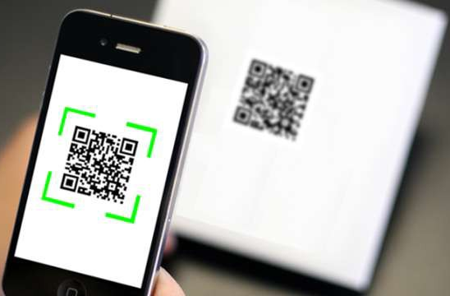
Attendance mobile application
1. Introduction
2. Scope
3. Team member and responsibility
4. Structure Project
5. gitHub project
6. prototype

Slide 4
Introduction
Staff attendance system using QR code
Most of all company are temporarily banning the use of biometrics in checking the staff' daily time records because of Covid-19 problem, the use of QR codes is a great technological substitute for checking their daily time records.
Since the staff only need to scan their corresponding QR code attendance, the chance of infecting each other with a communicable disease lessens.
Because of that, offices can use a QR code attendance into their attendance checking routines for a smooth and safe daily time recording.
Benefits of using a QR code attendance
QR codes are known to be the cost-efficient technological tool that many businesses use in keeping a contactless operation.
With the use of a QR code attendance system, institutions can implement a secure and safe attendance checking system without the need of spending more in maintaining them.

Slide 5

Scope
There are a various functionalities of staff and attendance are useful to be added in staff mobile app.
By concerning of the time, the limitation of functionalities is set to the following:
- Staff login page: To identify the staff identify
- Scan QR code for submitting attendance
- List history of attendance including search option by date

Slide 6

Team member and responsibility
1. SOK RATHANA
Role: Project manager Tasks: Responsible for Initiating, planning, organizing, and directing the completion project within scope
2. KHIEV SOVISAL
Role: Developer
Tasks: Generate company QR code, develop scan attendance functions.
3. VONG SOVANNDARA
Role: Developer
Tasks: Initial main project structure, build attendance result list.
4. RA BOREY
Role: Tester, test attendance mobile application
5. SUOS DARA
Role: Tester, test attendance mobile application

Slide 7
Structure Project
Login
Time In/Out
Home page with 2 menu:
- Time In/Out
- Attendance list
Left menu:
- Staff info
- Time In/Out
- Attendance list
- Logout
Scan QR code
Try again
Match
No
Absent form message
Yes
Present form success
Attendance upload into database
End

Slide 8
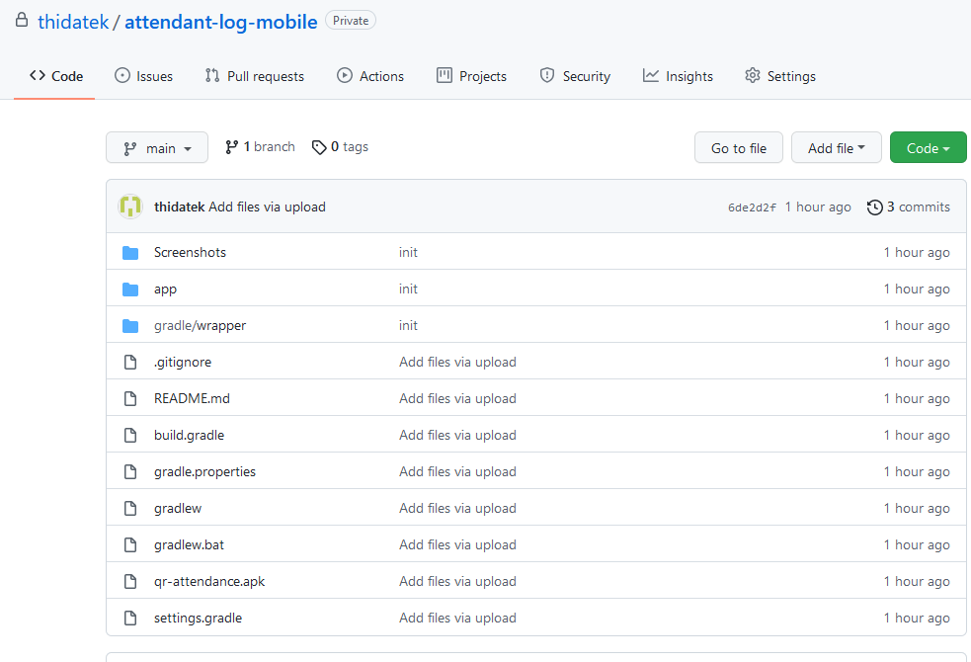
gitHub project
https://github.com/thidatek/attendant-log-mobile.git

Slide 9
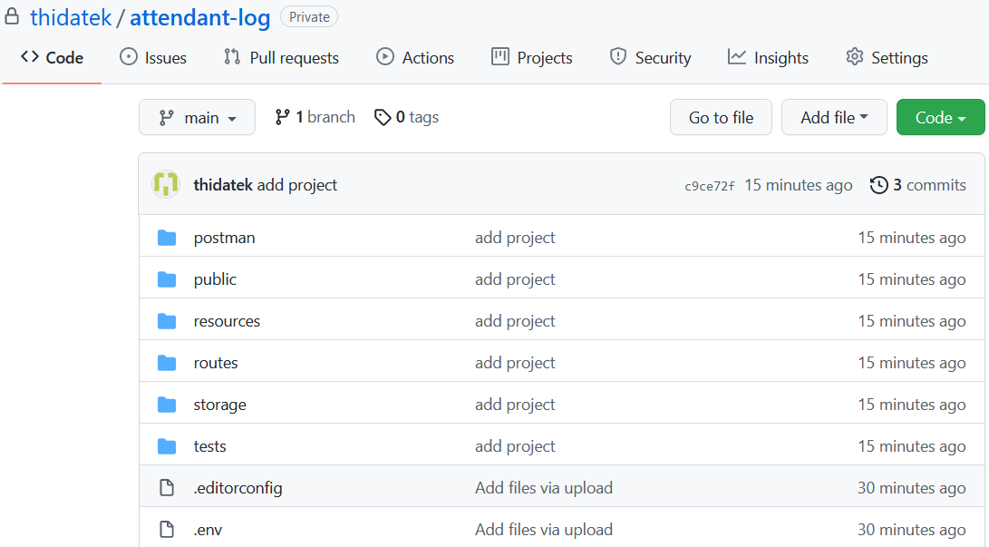
gitHub project
https://github.com/thidatek/attendant-log.git

Slide 10
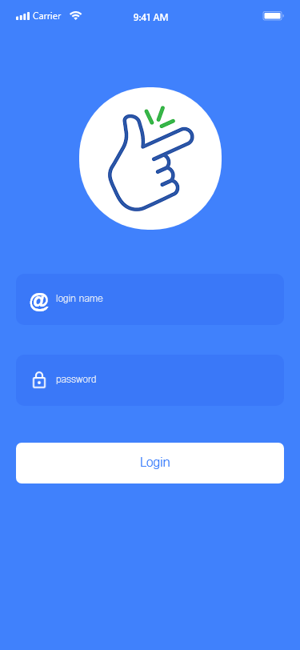
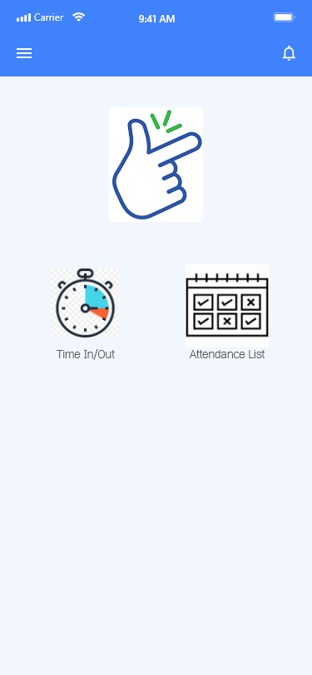
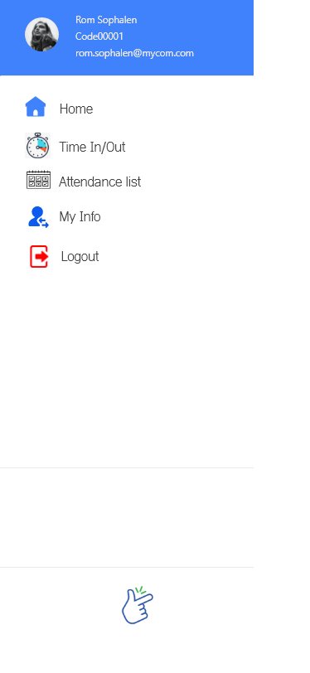
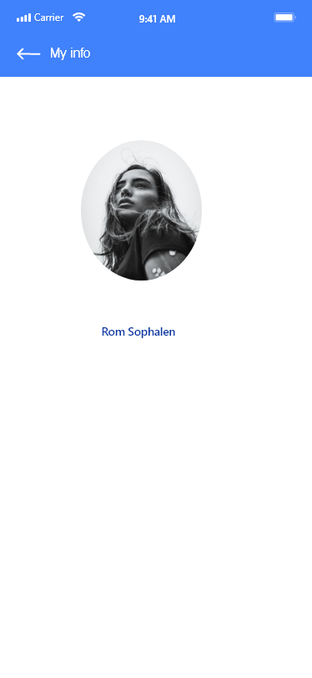
prototype

Slide 11
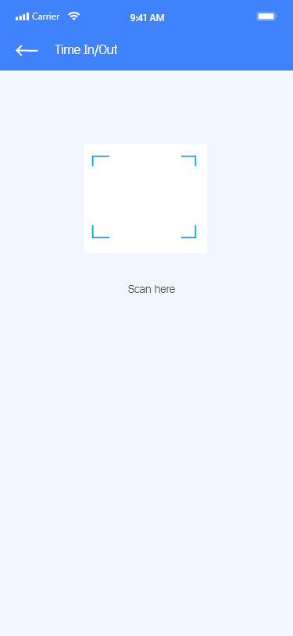
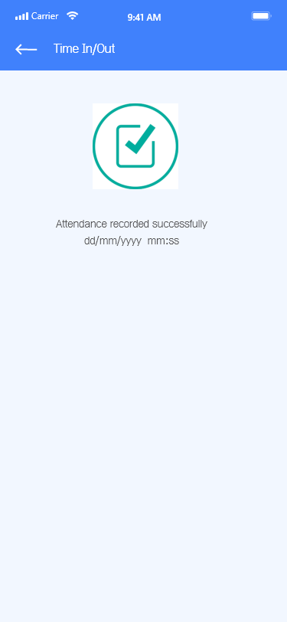
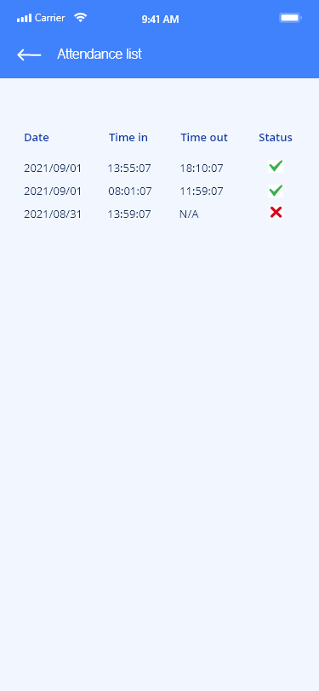
prototype

Slide 12

Progress
1. Have you had all documents references to do your topic?
2. Have you arrange all algorithms/pseudocodes to do your topic? Can you give a quick view in one page.
3. Have you structure your Core/API project yet? (e.g. existing API or laravel or wordpress or .net or java spring etc.)
4. Have you structure your Android project: Menu / Process activity screen etc.?
5. How many percentage now?

Slide 13
Progress
2. Have you arrange all algorithms/pseudocodes to do your topic? Can you give a quick view in one page.
3. Have you structure your Core/API project yet? (e.g. existing API or laravel or wordpress or .net or java spring etc.)
2
3
Company policy: 8am to 12am & 14pm to 18pm Generate office location: If the location is correct => attendance is recorded Attendance checking available: Morning: - In 7:30 am to 8:20am - Out 11:50 am to 12:30pm Afternoon - In 13:30pm to 14:20pm - Out 17:50 pm to 19:00pm | Technologies: API: laravel db: Postgresql Mobile: Native

Slide 14
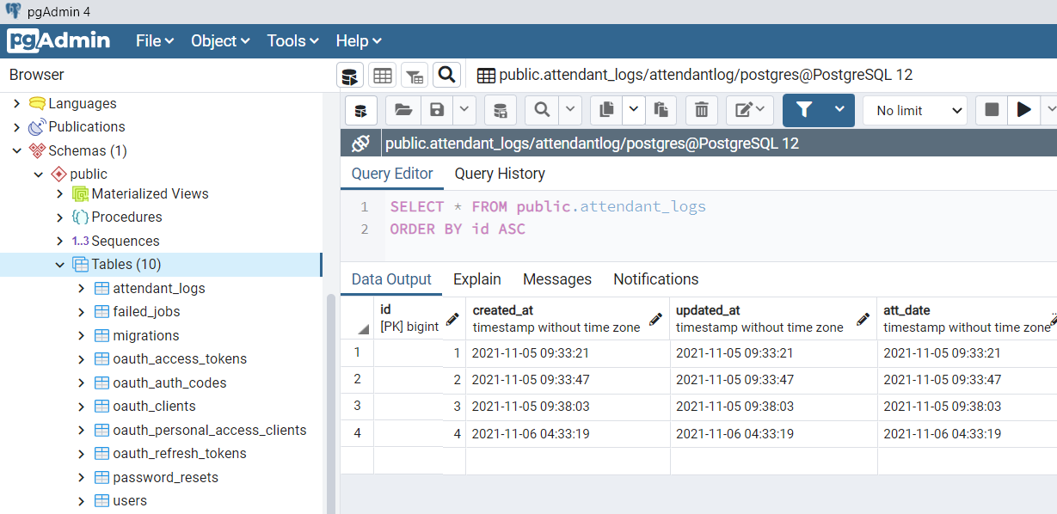
Database

Slide 15
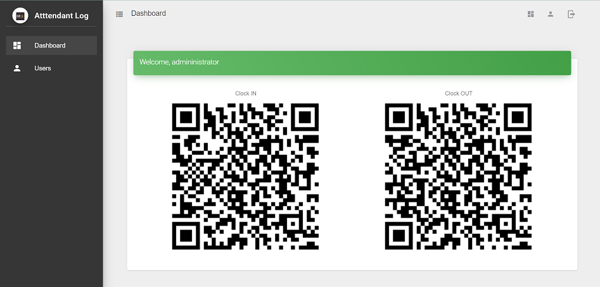
Backoffice screen

Slide 16
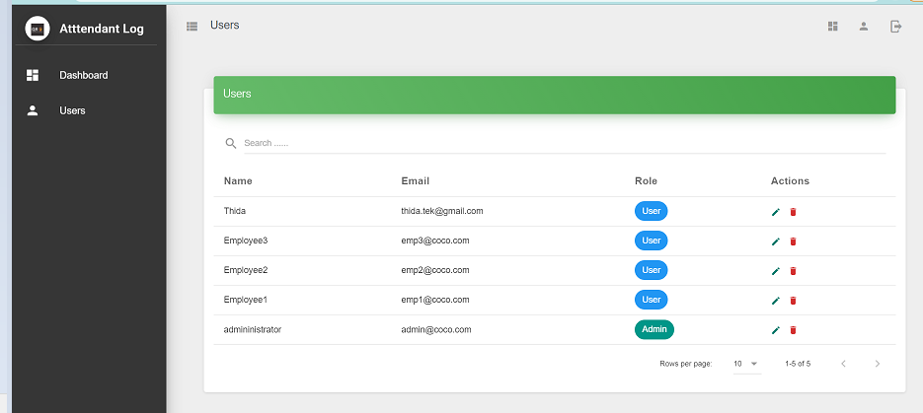
Backoffice screen

Slide 17


